Slide 1
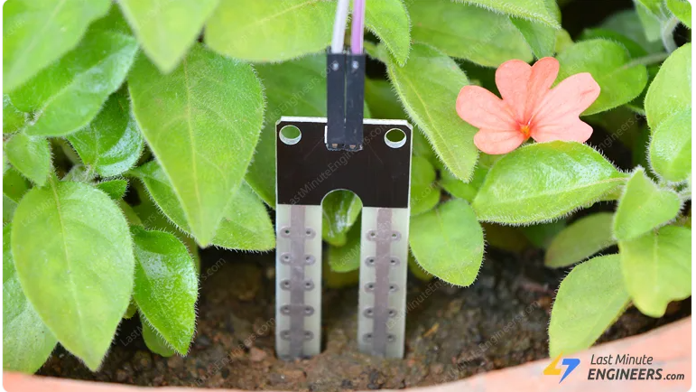
Instrumentation Project Presentation
BROUGHT TO YOU BY – “T A A J”
Project Title:- Moisture Detection in Soil
Members:- 1) Tejas Varade (200003082)
2) Ajeet Kumar (200003006)
3) Amit Dhavale(200003011)
4) Jyotirmay Mitra(200003038)

Slide 2
Problem Statement
Giving required amount of water to the crops in fields is an important part of Agriculture
However due to fluctuating supplies of electricity across fields, and also varying climatic conditions, which affect water levels, it becomes difficult to control the pumps manually.
Hence we present a low cost electronic solution to control the ON and OFF states of the pump depending on the defined level of water in the soil and availability of electrical supply.

Slide 3
Bill of Materials
SR NO | Component Specification | Quantity | Unit Price | Total Price
1 | Capacitor 1000 micro F | 1 | 2.4 | 2.4
2 | Resistor 1K ohm | 2 | 0.69 | 1.38
3 | IC 7404 | 5 | 20 | 100
4 | IC 7812 | 1 | 11 | 11
5 | Diode 1N4007 | 5 | 0.5 | 2.5
6 | Bulb 230 V | 1 | 95 | 95
7 | 5 way Rotary Switch | 2 | 40 | 80
8 | Relay 5V | 1 | 30 | 30
9 | Transformer 18V SD | 1 | 59 | 59
10 | Breadboard | 1 | 200 | 200
11 | Jumper Wires | 25 | 50 per pack | 50
12 | Plywood 2 * 1 ft2 | 1 | 80 | 80
 |  |  | Total | 711.28

Slide 4
Working Principle
Electrical conducting property of wet soil
Whereas dry soil acts as an insulator
when two probes, one at ground level and other at desired level deep in ground, get short due to electrical conductivity of wet soil, it shows that required level is reached and the supply to the pump is cutoff…

Slide 5
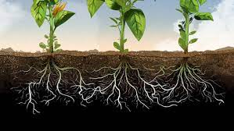
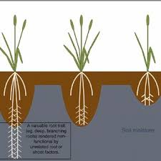
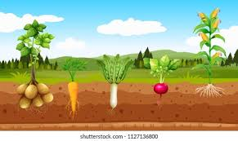

Slide 6
BLOCK DIAGRAM
MOISTURE
PROBE
NOT GATE
ROTARY SWITCH 2
RELAY
BULB
1
3
3, 4
2, 3
5
RECTIFIER
ROTARY SWITCH 1
SR NO | SPECIFICATION
1 | SENSING ELEMENT
2 | VARIABLE CONVERTOR
3 | DATA TRANSMITTER
4 | DATA MANIPULATOR
5 | DATA REPRESENTOR
6 | SUPPLY MANIPULATOR
6
3, 4
AC MAINS SUPPLY

Slide 7
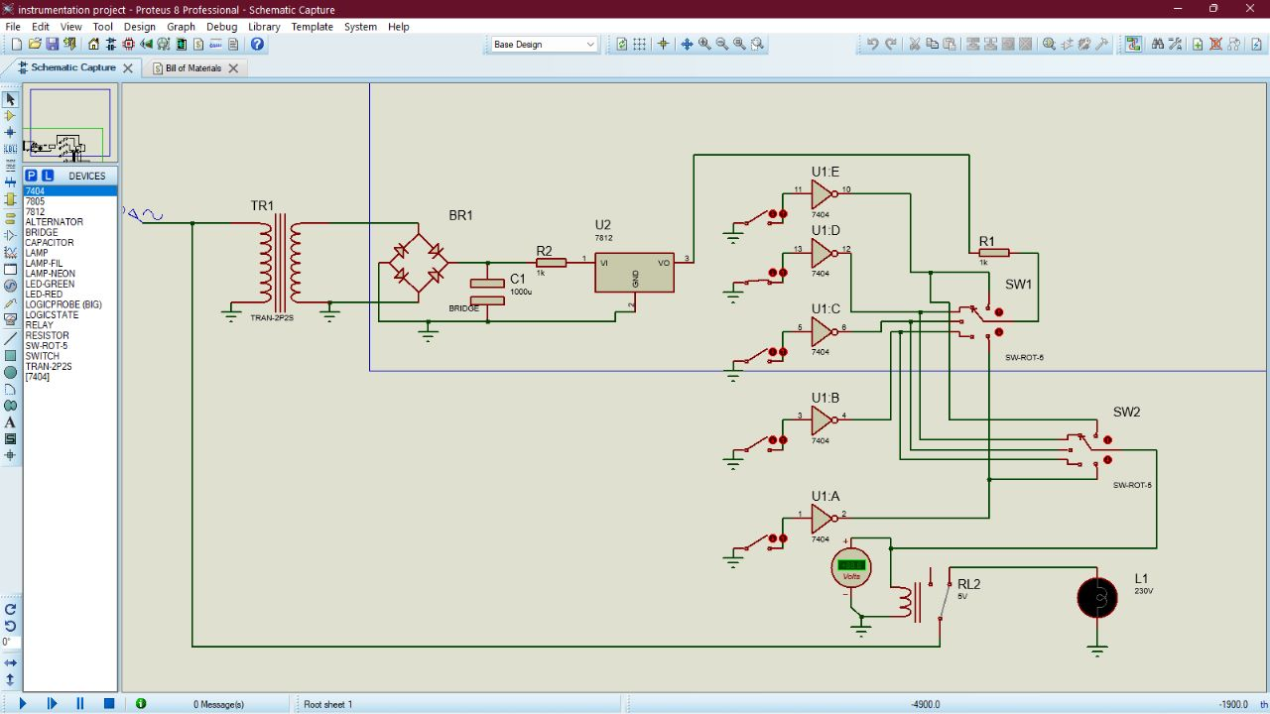
Circuit Diagram

Slide 8
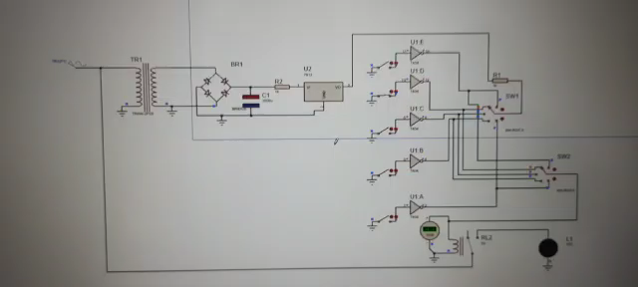
CIRCUIT VIDEO

Slide 9
Conclusion and Applications
A frugal solution is given to determine the soil moisture in terms of the water column present in the soil
It will help to efficiently use the water and energy resources
Also it will help farmer to reduce his / her efforts and wastage of time
It will help to increase productivity of crops
It will reduce soil erosion and maintain soil fertility…

Slide 10
References
Proteus 8 Professional – for circuit design and simulation
Ourselves

Slide 11
DHANYAVAAD நன்ற

